Slide 1

Portfolio Executive Committee (PEC) Review Meeting
TA INFL
To insert a wordmark:
Add (e.g. via drag and drop) your wordmark file (in RGB) to this slide (in alignment with our brand governance and architecture guidelines)
Change the size of the wordmark according to the height reference (magenta placeholder)
Select the “guides” in the navigation bar and move the wordmark to the right and top line (orange)
  Helen Tao & Team | Dec. 15th, 2025 | 20 min

Slide 2
Part I:
Follow-up Actions from the Previous PEC
PEC action log

Slide 3

Follow up actions from previous PEC (Nov. 2025)
No open actions for TA INFL team.

Slide 4
Part II: Pipeline Update

Slide 5
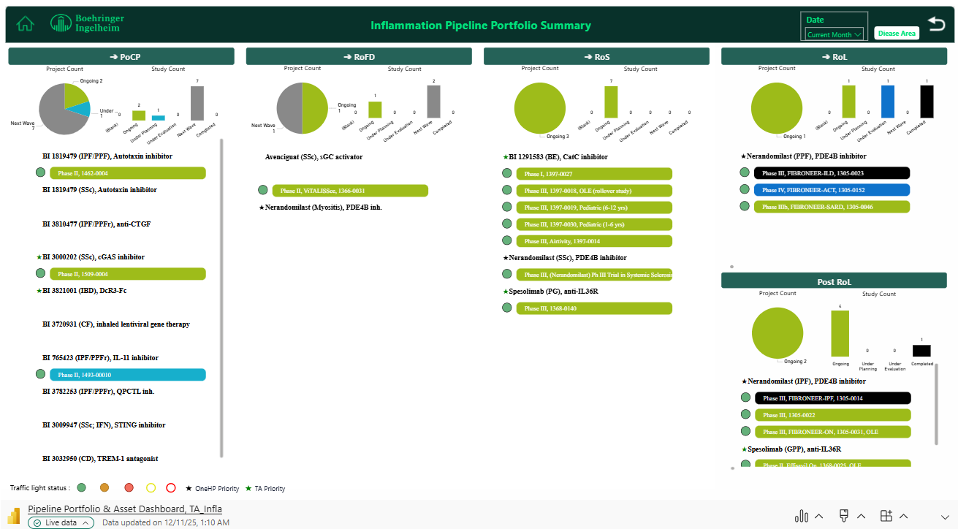
TA INFL Portfolio Summary - Pipeline Projects
Status: Dec. 11th, 2025

Slide 6
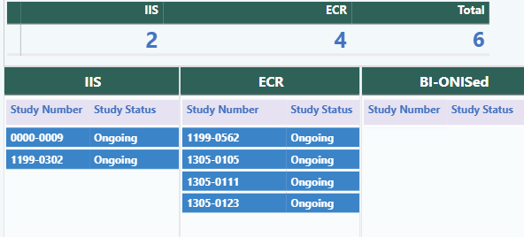

TA INFL Portfolio Summary - PMS Studies
New studies: NA
Status change:
  1199-0562, IPF survey, Ph II enrollment ongoing, 91(+54)/245 (actual/plan) enrolled, supplemental contract signed
  0000-0009, multimodal AI tool to early predict IPF, proposal released on Nov 24th

Slide 7
Update Nerandomilast

Slide 8
Overview: China Development Plan - Nerandomilast
Projects | Study ID | Current status | NDA approval (best case)
IPF | 1305-0024 Phase 1 CN PK study | Completed | /
 | 1305-0014 FIBRONEER-IPF, ph3, IPF | NDA approved | US: Oct 7, 2025 CN: Oct 21, 2025
 | 1305-0031 FIBRONEER-ON, ph3 OLE, IPF + PPF | Follow-up ongoing | /
PPF | 1305-0023 FIBRONEER-ILD, ph3, PPF | NDA approved | US: Jan 2026 CN: Dec 9, 2025
 | 1305-0046 FIBRONEER-SARD, ph3b, SARD-ILD | Recruitment ongoing | /
 | 1305-0152 FIBRONEER-ACT, ph4, non-IPF fibrotic ILD | Under evaluation | /
chILD | 1305-0022 Ph3, chILD | Pre-IND feedback received | US: Sep 2030 CN: Oct 2030
SSc | 1305-0052 Ph3, SSc | Pre-IND feedback received | US: Feb 2031 CN: Jul 2031
IIM | 1305-0146 Ph3, IIM | Under evaluation | US: Dec 2030 CN: Jun 2031

Slide 9



Nerandomilast (PDE4b inhibitor): Idiopathic Pulmonary Fibrosis(IPF) and Progressive Pulmonary Fibrosis (PPF) Development Plan
2022 |  |  |  | 2023 |  |  |  | 2024 |  |  |  | 2025 |  |  |  | 2026 |  |  |  | 2027
Q1 | Q2 | Q3 | Q4 | Q1 | Q2 | Q3 | Q4 | Q1 | Q2 | Q3 | Q4 | Q1 | Q2 | Q3 | Q4 | Q1 | Q2 | Q3 | Q4 | Q1
We are here
Ph3-1305.14
Sep 26
5Jun 2023
Aug 2024
IPF N=1077
US NDA Sub
7 Feb 2025
US NDA appr.
7 Oct 2025
FSS
LSS
Last patient Primary
endpoint
Ph3-1305.23
Nov 8
1Nov2023
Dec 2024
US NDA Sub
5 May 2025
US NDA appr.
Jan
PF-ILD N=1078
Ph3 OLE-
1305.31
Last patient Primary
endpoint
26Sep 2024
Jan 2027
Ph3 OLE
FSS
LSC
China
Jul2022
Dec2022
19 Feb 2025
12 Sep 2025
Oct 2025
Ph3-
1305.14
CTA Review + EC + HGRAC + 1st SIV (5.5 M)
CN ML N=97
TW: N=22
NDA review for IPF
CTA Sub
NDA Sub
CDE Panel Meeting
NDA Appr.
Dec 2026
Apr 30 2025
12 Nov 2025
Ph3-
1305.23
CTA Review + EC + HGRAC + 1st SIV (5.5 M)
Allocated China ML N=155, TW: N=28
NDA review for PPF
CTA Sub
1st SIV
26Sep 2024
NDA Sub
CDE Panel Meeting
NDA App
Jan 2027
Sep 2023
CTA Review + EC + HGRAC + 1st SIV
Ph3 OLE-
1305.31
FSS
LSC
LSS: Last subject screening
LSLV: Last subject last visit
DBL: database lock
HAI: Healthy authority interaction
INN: International Nonproprietary Names
ChP: Chinese Pharmacopoeia Commission
BE: Bioequivalence
OLE: Open label extension
China PK 1305.24
13 Jan 2023
17Mar2023
14Jul2023
Jan 2024
CTA Review + EC + HGRAC (6M)
CN PK
CTA Sub
SIV
LPO
DBL
CTR

Slide 10


Nerandomilast NDA Update
We are here
Approval
10/7
IPF
Priority Review granted
1/24
NDA sub. with DBL1
2/19
IPF type III meeting request sub. with DBL2
5/29
GCP inspection finished
7/7
Panel meeting
(Sept 12)
QC done
6/13
Approval
TMP, CNTS and PI negotiation
2025
2026
Jan | Feb | Mar | Apr | May | Jun | Jul | Aug | Sep | Oct | Nov | Dec | Jan | Feb | Mar
PPF
PI negotiation
NDA sub. with DBL1
4/30
Priority Review granted
5/16
Type III meeting request sub. with DBL2
8/13
GCP inspection
Aug 25-28
Panel meeting
(Nov 12)
Approval
12/9
US status: PI negotiation is currently in progress.
CN status: The NDA was approved on Dec 9th, making China the first country globally to obtain NDA approval for the PPF indication!
Approval
1/5/2026

Slide 11
CN PPF PI Summary
Indications：This product is indicated for the treatment of Progressive Pulmonary Fibrosis (PPF) in adult patients.
Dosage: The recommended dosage of this product is 18 mg twice daily, administered orally approximately 12 hours apart, with or without food.
- Recommended dosage is 18 mg twice daily when used concomitantly with pirfenidone. Do not reduce dosage to 9 mg twice daily
- Reduce to 9 mg twice daily for patients who are unable to tolerate 18 mg twice daily, except in patients who concomitantly use with pirfenidone.
Adverse reaction: Similar to IPF section.
Efficacy data: Includes the primary endpoint, along with subgroup analyses based on AF/non-AF status, HRCT patterns, and ILD diagnosis, as well as key secondary endpoint and mortality data.

Slide 12

Ongoing: Nerandomilast (PDE4b inhibitor): Systemic autoimmune rheumatic diseases-associated Interstitial Lung Diseases (SARD-ILD) Development Plan
2024 |  |  |  | 2025 |  |  |  | 2026 |  |  |  | 2027
Q1 | Q2 | Q3 | Q4 | Q1 | Q2 | Q3 | Q4 | Q1 | Q2 | Q3 | Q4 | Q1 | Q2 | Q3 | Q4
We are here
21 Aug 2024
22 Oct 2024
13 Sep 2025
15 Dec 2026
30 Jul 2027
30 Dec 2027
Ph3b-1305.46
Recruitment window = 16 M
152 sites, N = 400
CTA Sub
CTA appr
CTR
FSS
LSS
LPO
13 Sep 2025
15 Dec 2026
30 Jul 2027
21 Aug 2024
11 Nov 2024
CTA Review + EC + HGRAC + 1st SIV (6 M)
Recruitment window ~16 M
17 sites, N=27
Ph3b-1305.46
CTA Sub
CTA appr
FSS
LSS
LPO
Recruiment is ongoing.
TDO: trial design outline
FSS: first subject screen
LSS: last subject screen
LPO: last patient out

Slide 13
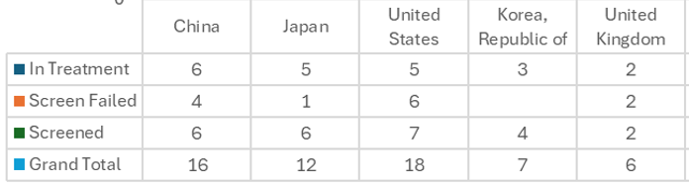
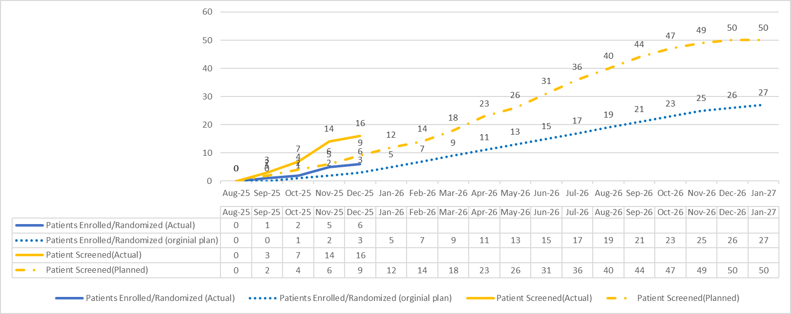
China Level Report: recruitment
Trial Number:
1305-0046
BI Substance:
BI 1015550
Mode of Action:
PDE4b inhibitor
Therapeutic Area:
INFL
Target population:
27 (China)
400 (Global)
Phase:
IIIb
Cut-off date: 2025.12.14
Total Screened = 16 (China) / 65 (Global)
Total Randomized = 6 (China) / 21 (Global)
Total Screen failure = 4 (China) / 13 (Global)
Screen failure rate = 25% (China) / 20% (Global)

Slide 14
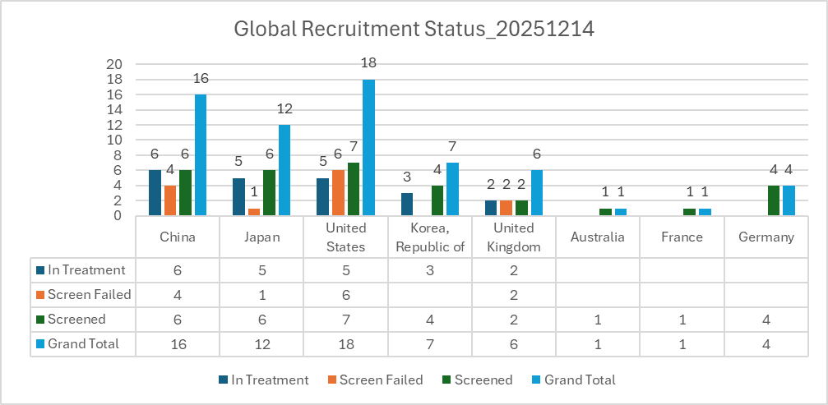
Global Level Report: recruitment
Trial Number:
1305-0046
BI Substance:
BI 1015550
Mode of Action:
PDE4b inhibitor
Therapeutic Area:
INFL
Target population:
27 (China)
400 (Global)
Phase:
IIIb
Cut-off date: 2025.12.14
Total Screened = 16 (China) / 65 (Global)
Total Randomized = 6 (China) / 21 (Global)
Total Screen failure = 4 (China) / 13 (Global)
Screen failure rate = 25% (China) / 20% (Global)

Slide 15
Under evaluation: Nerandomilast (PDE4b inhibitor): non-IPF fibrotic ILD Development Plan
2025 |  |  |  | 2026 |  |  |  | 2027 |  |  |  | 2028 |  |  |  | 2029
Q1 | Q2 | Q3 | Q4 | Q1 | Q2 | Q3 | Q4 | Q1 | Q2 | Q3 | Q4 | Q1 | Q2 | Q3 | Q4 | H1 | H2
We are here
30Apr 2026
30Aug 2026
Dec 2028
Ph4-1305.152
180 sites, N = 466
CTA Sub
FSS
LPO
TBU
TBU
Dec 2028
Ph4-1305.152
18 sites, N=49 (pre-liminary allocation)
CTA Sub
FSS
LPO
Global has agreed Prof. Luo Fengming's to join the Global Steering Committee. The contract has been signed in Nov, and Prof. Luo has been invited to participate in the Global SC meeting scheduled for Jan 2026.
Global early asset labeling team will initiate the evaluation of the possibility of label update based on FIBRONEER-ACT final TDO (end of Feb 2026).
TDO: trial design outline
FSS: first subject screen
LSS: last subject screen
LPO: last patient out

Slide 16
Endorsed: Nerandomilast (PDE4b inhibitor): Pediatric Fibrosing Interstitial Lung Diseases (chILD) Development Plan
2025 |  |  |  | 2026 |  |  |  | 2027 |  |  |  | 2028 |  |  |  | 2029 |  |  |  | 2030 |  | 2031 |  | 2032
Q1 | Q2 | Q3 | Q4 | Q1 | Q2 | Q3 | Q4 | Q1 | Q2 | Q3 | Q4 | Q1 | Q2 | Q3 | Q4 | Q1 | Q2 | Q3 | Q4 | H1 | H2 | H1 | H2 | H1 | H2
We are here
23 Mar 2026
18Mar 2029
24 Mar 2031
Ph3-1305.22 (include OLE)
Jan 2026
Feb
2026
23 Jun 2028
CTA sub.
CTA appr.
N = 30
FSS
LSS
Main DBL
OLE
LPO
9Jul 2029
9 Jan 2030
NDA sub.
NDA appr.
Ph3-1305.22 (include OLE)
12 Sep 2025
Feb
2026
1 Jun 2026
1 Sep 2026
3 sites, N=2
Pre-IND sub.
CTA sub.
CTA appr.
1st SIV
9 Aug 2029
9 Jun 2030
NDA sub.
NDA appr. (best case)
CDE feedback for chILD ph3 pre-IND received on Nov 25th : no comments from CDE clinical and nonclinical division; Additional simulations of PK parameters (eg. Cmax, Cmin) are suggested for a thorough dose selection evaluation.
The China CTA will be submitted following receipt of feedback from the FDA regarding the US CTA.

Slide 17
Endorsed: Nerandomilast (PDE4b inhibitor): Systemic Sclerosis (SSc) Development Plan
2025 |  |  |  | 2026 |  |  |  | 2027 |  |  |  | 2028 |  |  |  | 2029 |  |  |  | 2030 |  |  |  | 2031
Q1 | Q2 | Q3 | Q4 | Q1 | Q2 | Q3 | Q4 | Q1 | Q2 | Q3 | Q4 | Q1 | Q2 | Q3 | Q4 | Q1 | Q2 | Q3 | Q4 | Q1 | Q2 | Q3 | Q4 | Q1 | Q2 | Q3 | Q4
We are here
31Jan 2027
15Apr 2028
Ph2b-1305.40
CONQUEST Trial, SSc-ILD, ph2b
IA
Key results
15 Aug 2025
18 Nov 2025
20 May 2026
12Apr
2030
Aug
2030
Feb
2031
Ph3-1305.52
Feb 2026
SSc Ph3 (N=448)
RoFD
CTA sub.
DBL
NDA sub.
NDA appr.
HAI
FSS
China
21 Aug 2025
Mar
2026
Oct 2026
Sep
2030
Jul
2031
Ph3-
1305.52
SSc Ph3 (N=45)
HAI
CTA sub.
FSS
NDA sub.
NDA appr.
CDE feedback for pre-IND was received on Nov 10th. Considering about the potential risks with China CTA/EC approvals, team proposed to submit China CTA after FDA feedback on US CTA, which has been endorsed by CEC in Nov and aligned with global ET.
TDO was finalized on Nov 26th . On Dec 2nd. The study design was revised. Country allocation for China has been adjusted to 45 subjects from 25 sites (total sample size has been adjusted to 448 subjects).
Huashan hospital & BI Collaboration Exchange Meeting was successfully held on Dec 1st , during which SSc project was a key topic of discussion.

Slide 18
Under evaluation: Nerandomilast (PDE4b inhibitor): Idiopathic Inflammatory Myopathies (IIM) Development Plan
2025 |  |  |  | 2026 |  |  |  | 2027 |  |  |  | 2028 |  |  |  | 2029 |  |  |  | 2030 |  |  |  | 2031
Q1 | Q2 | Q3 | Q4 | Q1 | Q2 | Q3 | Q4 | Q1 | Q2 | Q3 | Q4 | Q1 | Q2 | Q3 | Q4 | Q1 | Q2 | Q3 | Q4 | Q1 | Q2 | Q3 | Q4 | Q1 | Q2 | Q3 | Q4
We are here
Ph3-1305.146
2 Jul 2025
5 Jan 2026
30 Mar 2026
Apr 2026
Sep 2026
Mar 2030
Jul 2030
Dec 2030
IIM Ph3 (TBC)
Release of SoD
HAI sub.
RoFD
CTA sub.
FSS
DBL
NDA sub.
NDA Appr.
China
Mid Jan
TBC
Aug 2030
Jun 2031
Ph3-
1305.146
TBU
HAI sub.
CTA sub.
NDA sub.
NDA Appr.
SoD for Nerandomilast in Myositis was released by HPSC on Jul 2nd, 2025.

Slide 19
Update Verducatib

Slide 20




BI 1291583/verducatib (CatC/DPP-1 inhibitor): Bronchiectasis
2022 |  | 2023 |  |  |  | 2024 |  |  |  | 2025 |  |  |  | 2026 |  |  |  | 2027 |  |  |  | 2028 |  |  |  | 2029 |  | 2030
Q3 | Q4 | Q1 | Q2 | Q3 | Q4 | Q1 | Q2 | Q3 | Q4 | Q1 | Q2 | Q3 | Q4 | Q1 | Q2 | Q3 | Q4 | Q1 | Q2 | Q3 | Q4 | Q1 | Q2 | Q3 | Q4 | H1 | H2 | H1 | H2
Phase 2
1397-0012
Jan 2023
Sep 2023
Jun 2024
Dec 2024
Airleaf Ph II 1397-0012
Aug 2022
PoCC
RoFD
PoCP
LSS
Nov 2023
Q4 2024
Phase 2
1397-0013
Clairafly 1397-0013 CF Profiling study
Q3 2023
Q3 2026
Phase 2
1397-0017
Clairleaf Phase 2 CFBE + nCFBE roll-over study
Feb 2025
16 Jun 2025 FSS
20 Sep 2027, DBL
Dec 2027
Aug 2028
Phase 3
1397-0014
AIRTIVITY 1397-0014 Phase 3
CTA
US NDA
US Approval
Phase 3
1397-0018
1397-0018 Phase 3 nCFB+/- CFB roll-over study
Sep 2024
Feb 2025
Jul 2025
Dec 2027
Best: Dec 2028
Base: June 2029
Phase 3
1397-0014
CTA Review + EC + HGRAC + 1st SIV (6m) *
AIRTIVITY 1397-0014 Phase 3
EoP2 HAI
Req. Subm.
CTA
1st SIV
CN NDA
China Approval
China Approval
Phase 3
1397-0018
1397-0018 Phase 3 nCFB+/- CFB roll-over study
Phase 1 PK
1397-0027
13 Jul 2026
11 Oct 2026
Apr 2027
Protocol develop
CTA Review + EC + HGRAC + 1st SIV (6m) *
China PK
FSS
LSO
Key PK results
we are here
AB, Advisory board; TDO, Trial Design Outline

Slide 21

NDA Submission Strategy Snapshot
2022 |  | 2023 |  |  |  | 2024 |  |  |  | 2025 |  |  |  | 2026 |  |  |  | 2027 |  |  |  | 2028 |  |  |  | 2029 |  |  | 2030
Q3 | Q4 | Q1 | Q2 | Q3 | Q4 | Q1 | Q2 | Q3 | Q4 | Q1 | Q2 | Q3 | Q4 | Q1 | Q2 | Q3 | Q4 | Q1 | Q2 | Q3 | Q4 | Q1 | Q2 | Q3 | Q4 | H1 |  | H2 | H1 | H2
Phase 3 1397-0014
Feb 2025
16 Jun 2025 FSS
Dec 2027
Aug 2028
AIRTIVITY 1397-0014 Phase 3
CTA
LPI (adults)
US NDA
US Approval
LPI (adols.)
LPI (adols.)
Sep 2024
Feb 2025
Jul 2025
Dec 2027
Best: Dec 2028
Base: June 2029
CTA Review + EC + HGRAC + 1st SIV (6m) *
AIRTIVITY 1397-0014 Phase 3
EoP2 HAI
Req. Subm.
CTA
1st SIV
LPI (adults)
CN NDA
China Approval
China Approval
LPI (adols.)
LPI (adols.)
DBL-1
Sep 2027
DBL-2
Mar/Apr 2028
Ready to recruit adult pts
NDA with Data from all adult pts & Data from partial of the planned adolescent pts
SNDA with data from all adolescent pts
CTP v1
1680 (only enroll adults)
1440 NCFBE
240 CFBE
CTP v1
Ready to recruit adol. pts
CTP v2
1680 adults
1440 NCFBE
240 CFBE
CTP v2
1755 (1680 adults + 75 adols)
Global challenge: to simultaneously complete adol. recruitment with adults recruitment
5 months recruitment window for adolescent pts. (critical path)
75 adolescents
≥70% NCFBE
≤30%CFBE

Slide 22
BI 1291583/verducatib (CatC/DPP-1 inhibitor): Bronchiectasis
2022 |  | 2023 |  |  |  | 2024 |  |  |  | 2025 |  |  |  | 2026 |  |  |  | 2027 |  |  |  | 2028 |  |  |  | 2029 |  | 2030
Q3 | Q4 | Q1 | Q2 | Q3 | Q4 | Q1 | Q2 | Q3 | Q4 | Q1 | Q2 | Q3 | Q4 | Q1 | Q2 | Q3 | Q4 | Q1 | Q2 | Q3 | Q4 | Q1 | Q2 | Q3 | Q4 | H1 | H2 | H1 | H2
Feb 2025
16 Jun 2025 FSS
19 Dec 2028, DBL
Mar 2029
Nov 2029
Phase 3
1397-0014
AIRTIVITY 1397-0014 Phase 3
CTA
US NDA
US Approval
Phase 3
1397-0018
1397-0018 Phase 3 nCFB+/- CFB roll-over study
Sep 2024
Feb 2025
Jul 2025
Phase 3
1397-0014
CTA Review + EC + HGRAC + 1st SIV (6m) *
AIRTIVITY 1397-0014 Phase 3
Best: Mar2030
Base: Sep2030
EoP2 HAI
Req. Subm.
CTA
1st SIV
Phase 3
1397-0018
Initial timeline
1397-0018 Phase 3 nCFB+/- CFB roll-over study
China Approval
16 Jun 2025 FSS
20 Sep 2027, DBL
Feb 2028
Oct 2028
Updated timeline
AIRTIVITY 1397-0014 Phase 3
US NDA Sub.
US Approval
Feb 2028
Feb 2029
CN NDA Approval | Best Case | Base Case
Initial timeline | Mar 2030 | Sep 2030
Updated timeline | Feb 2029 | Aug 2029
20 Sep 2027, DBL
AIRTIVITY 1397-0014 Phase 3
China NDA Sub.
CN Approval (best case)
DBL: - 14.7 months
Aug 2029
CN Approval (base case)
CN Approval: - 13 months
(best or base case)
we are here
Nov 17, 2025
Notes:
All adult subjects are expected to complete the trial by 2 August 2027.
All adolescent subjects are expected to complete the trial by April 2028.

Slide 23












Verducatib – Approval timeline in focus countries (adults + adols)
(not finalized for socialization)
 | 2027 |  |  |  | 2028 |  |  |  |  |  |  |  |  |  |  |  | 2029
 | 9 | 10 | 11 | 12 | 1 | 2 | 3 | 4 | 5 | 6 | 7 | 8 | 9 | 10 | 11 | 12 | 1 | 2 | 3 | 4 | 5 | 6 | 7 | 8 | 9 | 10 | 11 | 12
Milestone
Best Submission
Base Submission
DBL, 20 Sep 2027​
US/EU NDA Subm
US approval & launch (best)
US approval & launch (base)
JP NDA Subm
JP approval (best)
JP approval (base)
CN NDA Subm
CN approval & Lanuch (best)
CN approval & Launch (base)
US/EU NDA Subm
US approval & launch (best)
JP NDA Subm
JP approval (best)
JP approval (base)
CN NDA Subm
CN approval & Launch (best)
CN approval & Launch (base)

Slide 24
Global recruitment Status – by 12 Dec 2025
Total screening：716
Total randomization：368
SF：78
In screening：266
Withdrawal：4
SF ：10.8%

Slide 25
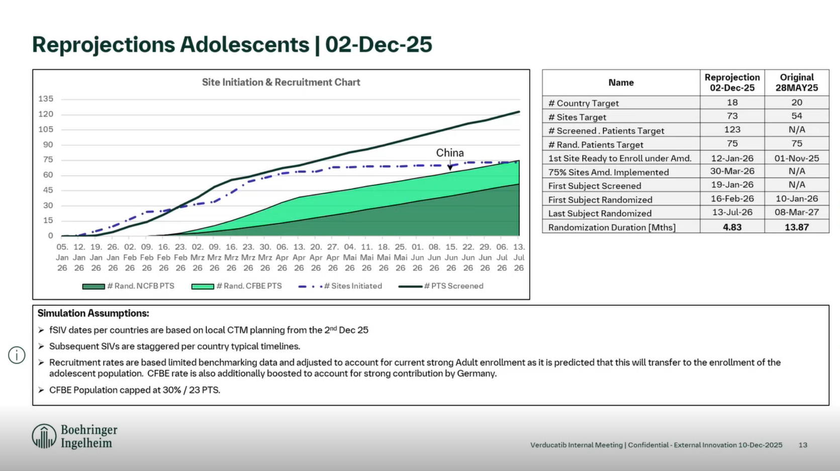

Slide 26
China recruitment Status – by 12 Dec 2025 (initial projection)
Total screening：134
Total randomization：80
SF：21
In screening：33
withdrawal：1
SF%：15.6%

Slide 27
China recruitment Status – by 12 Dec 2025 (accelerated projection)

Slide 28


Recruitment Status – by 12 Dec 2025
 | Global |  |  | Mainland China
 | Planned | Actual | Completion % | Planned | Actual | Completion %
Screening | 2400 | 716 | 29.8% | 309 | 134 | 43.3%
Randomization | 1680 | 368 | 21.9% | 201 | 80 | 39.8%
Screening Top 3 | Randomization Top 3
China (134) 🥇 | China (80)🥇
Germany (117) | Germany (79)
US (97) | US (52)
Shout-out to CD&O team
THANKS to Cross-functional support

Slide 29
Next step actions – trial acceleration
Trial acceleration strategy implementation:
    Virtual IM (done)
    Key site/PI engagement/visit...
    Trial quality
To ensure adol. recruitment completes simultaneously with adult recruitment (one LPI goal)
    Shorter recruiment window for adolescent pts (n=75) - critical path to have a broader labeled indication (adults+adols)
    Quick SIV for 2 new sites for adols and closely monitor site performance
Launch readiness
    Launch readiness preparations have been planned.

Slide 30
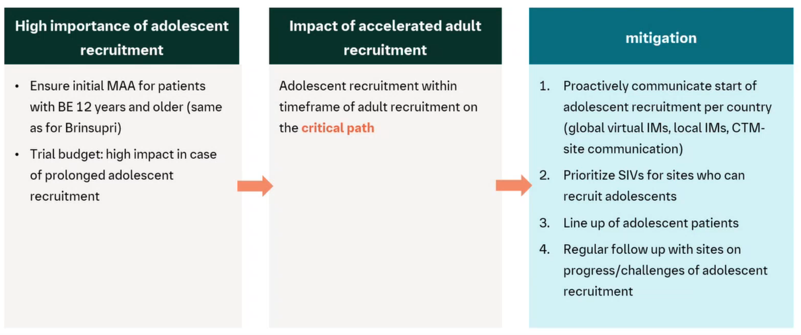
Next step actions
Trial acceleration strategy implementation:
    Virtual IM (done)
    Key site/PI engagement/visit...
To ensure adol. recruitment completes simultaneously with adult recruitment (one LPI goal)
    Shorter recruiment window for adolescent pts (n=75) - critical path to have a broader labeled indication (adults+adols)
    Quickly SIV for 2 new sites for adols and closely monitor site performance
Launch readiness
    Launch readiness preparations have been planned.

Slide 31
New Timeline Projection Breakdown
Backup slide
 | Old | New
75% Sites initiated | May 2026 | 24 Nov 2025
# Sites target | 500 | 500
# Country Target | 49 | 46
Screening Failure Rate | 30% | 24%
FSR | 28 Jul 2025 | 01 Jul 2025
LSR | 16 Sep 2027 | 06 Jul 2026
Recruitment Duration (months) | 25.64 | 12.16
Last Subject Last Visit (52 weeks) | 14 Sep 2028 | 05 Jul 2027
Last Subject Completed (incl. FUP) | 12 Oct 2028 | 02 Aug 2027
To date, almost 75% of the planned sites have been initiated across 38 countries, resulting in strong recruitment performance since July.
Currently, 10% of the planned adult population has been randomized.
Screen failure rate of 24%
Last Randomized adult Subject is projected by 6 July 2026, which is more than a year ahead of the original schedule!
Last Randomized adolescent Subject currently projected for March 2027.
We will continue to monitor recruitment, including below populations:
  240 adult CF patients
Notes:
To date, almost 75% of the planned sites have been initiated across 38 countries, resulting in strong recruitment performance since July.
Currently, 10% of the planned adult population has been randomized. See further details attached.
At the current recruitment pace - and with a lower screen failure rate of 24%：
the Last Randomized adult Subject is projected by 6 July 2026, which is more than a year ahead of the original schedule!
Recruitment of adolescent subjects is expected to continue beyond this date, with the Last Randomized adolescent Subject currently projected for March 2027.
We will continue to monitor recruitment, including below populations:
30% of patients with a history of one PEX
240 adult CF patients
10% from Eastern Europe
20% COPD/asthma patients

Slide 32
Potential Impact of Trial Timeline Acceleration (by >14 months) on China Activities
Impact on China Activities | Grade of impact | Notes
Recruitment (with speed and quality) within a shortened recruitment window (>2y to 1y) | Minimal to Moderate | Current recruitment is ahead of the planned schedule (globally and locally) Next step action would be to further speed up to meet the new timeline requirements
China ph1 PK study timeline | Minimal | Currently planned timeline is not on the critical path: CTA: 09 Jan 2026 First Subject Screened: 13Jul2026 Last Subject Randomized: 3 Aug 2026 DBL: Jan 2027
China RWE study timeline | Minimal | Initial timeline (Start from Q4 2026, completed by Q4 2028) is sufficient to support launch and NRDL.
OLE study CTA submission | Minimal | CTA timeline for OLE is flexible, not on critical path to acceleration of ph3 trial.
Pediatric study CTA | Minimal | Timeline moved up for 6-12y study to 08-Sep-2028.
Launch readiness & preparation timeline | Moderate | Under discussion
Notes:
RWE (time & cost):
2026 internal process
2027 start – analysis available in 2027 医保数据库
2028 Data publication

Slide 33
Overview: Future Development Activities in China - verducatib
Study ID (name) Phase | Population | Sample size (CN/Global) | Planned Activities | Purpose | Timeline
- Already planned/endorsed (China join-in and China standalone PK study)
1397-0014 Airtivity study Phase 3 | adult BE pts | n=201/1680 | HA submission of protocol amendment (v2) for the inclusion of adolescents (12-18y) | To support the inclusion of adolescents in future labeled population Approval expected by end of Dec. 2025 | Sep 17th , 2025
1397-0027 Phase 1 China PK study | HV | n=12 | China CTA submission for China ph1 PK study | To collect PK data from Chinese population to support future China NDA | Jan 2026
1397-0018 Airtivity-on(tbd) study Phase 3 OLE of AIRTIVITY | adult BE pts | China CTA submission for ph3 OLE study | To collect long-term safety (and efficacy) data from phase 3 Airtivity study population | Tbd, 2026
1397-0019​ Phase 3 | peds BE pts (6-12y) | Completed HA consultation for pediatric development plan (1-＜12y) with positive feedback received on Sep 02, 2025 | To support the extension to pediatric population (1-12y) in future labeled population | CTA: tbd in 2028
1397-0030​ Phase 3 | peds BE pts (1-6y)
- Tentatively for future discussion
1397-0032 (tbd) Phase 3 | ANCA-AV pts (Discussion ongoing globally) | Development of this indication was terminated in Sep 2024 with timeline mapped | To support line extension and extend market exclusivity. Global Go or No-go decision is expected in Q1 2026 | tbd
Adults/Adols.
Peds.
* BE=bronchiectasis; pts=patients; HV=healthy volunteers; Adols.=adolescents; Peds=pediatrics
Notes:
Extensions of indication

Slide 34
Update Spesolimab

Slide 35
Overview: China Development Plan - Spesolimab
Projects | Study ID | Current status | Planned start of operational transfer*
GPP | 1368-0025 Effisayil ON, ph2, Open label extention study | Recruitment completed, treatment ongoing | Q1-2026
 | 1368-0120 Effisayil REP, ph3b/4, GPP flare retreatment | Recruitment completed, treatment ongoing | N/A, Completion to Final CTR: Feb 2027
PG | 1368-0140 Capsayil, Ph3, PG | Recruitment ongoing | N/A, Completion to Final DBL: Feb 2028
NS | 1368-0104 Ph2/3, NS | Terminated | /
HS | 1368-0098 Ph2b/3, HS | Terminated | /
* Source: Spevigo licensing and transfer to Leo Pharma Playbook for Countries, Date: 30 September 2025

Slide 36
Spesolimab (Anti-IL36R): General Pustular Psoriasis (GPP)
2020 |  | 2021 |  | 2022 |  | 2023 |  | 2023 |  | 2024 |  | 2024 |  | 2025 |  | 2023 |  | 2026 |  | 2024 |  | 2027
Q1 Q2 | Q3 Q4 | Q1 Q2 | Q3 Q4 | Q1 Q2 | Q3 Q4 | Q1 | Q2 | Q3 | Q4 | Q1 | Q2 | Q3 | Q4 | Q1 | Q2 | Q3 | Q4 | Q1 | Q2 | Q3 | Q4 | Q1 Q2 | Q3 Q4
We are here
NDA App (US)
for GPP Flare Sep 2022
Oct 2023
Jun 2024
Nov 2026
Ph3b/4-1368.120
recruitment (N=40)
FSS
LSS
LSC
Ph2 OLE-1368.25
Feb 2023
Jan 2028
N=130
LSS
LSC
NDA App for GPP Flare
CN ML: 13Dec2022
TW: 6Jan2023
Jun 2023
16Oct2023
Jun 2024
Nov 2026
Ph3b/4-1368.120
EC + HGRAC + 1st SIV
China Mainland: N=5 TW: N=2
1st SIV
LSS
LSC
Ph2 OLE-1368.25
Sep 2020
Oct 2022
Dec 2027
N=14
1st SIV
LSS
LSC
1368-0025 OLE study [No updates since last meeting] : Planned start of operational transfer in Q1 2026*
1368-0120 Flare retreatment study [No updates since last meeting] :
DBL for planned interim analysis on 29Aug2025
Completion to final CTR* in Feb 2027
FSS: First subject screening
LSS: Last subject screening
LSC: Last subject complete
LSR: Last subject randomization
CN ML: China mainland
TW: Taiwan
SF: Screen failure
* Source: Spevigo licensing and transfer to Leo Pharma Playbook for Countries, Date: 30 September 2025

Slide 37
Spesolimab (Anti-IL36R): Pyoderma Gangrenosum (PG)
2024 |  |  |  | 2025 |  |  |  | 2026 |  |  |  | 2027 |  |  |  | 2028
Q1 | Q2 | Q3 | Q4 | Q1 | Q2 | Q3 | Q4 | Q1 | Q2 | Q3 | Q4 | Q1 | Q2 | Q3 | Q4 | Q1
We are here
FSS: 4Feb2025
Oot2026
Feb 2028
CTA Jul 2024
1st SIV: 14Jan2025
FSS-LSR n=90, recruit. Window: ~21m,
LSR-LSC
Pre-IND
CTA Review + EC + HGRAC
FSS-LSR n=14, recruit. window: ~18m
LSR-LSC
Meeting request
Jan2024
CTA Jul2024
1st SIV: 15Jan 2025
FSS: 20Feb2025
Aug2026
Dec 2027
FSS: First subject screening
LSS: Last subject screening
LSC: Last subject complete
LSR: Last subject randomization
Recruitment timeline extended for ~4 months on 4Sep:
  Changed Total Screened to 206 from 134
  Changed Last Subject Randomized to Oct 2026 from Jun 2026
      China mainland: changed to Aug 2026 from Apr 2026
  Changed DBL date to Feb 2028 from Oct 2027

Slide 38
Spesolimab (Anti-IL36R): Pyoderma Gangrenosum (PG)
2024 |  |  |  | 2025 |  |  |  | 2026 |  |  |  | 2027 |  |  |  | 2028
Q1 | Q2 | Q3 | Q4 | Q1 | Q2 | Q3 | Q4 | Q1 | Q2 | Q3 | Q4 | Q1 | Q2 | Q3 | Q4 | Q1
We are here
FSS: 4Feb2025
Oot2026
Feb 2028
CTA Jul 2024
1st SIV: 14Jan2025
FSS-LSR n=90, recruit. Window: ~21m,
LSR-LSC
Pre-IND
CTA Review + EC + HGRAC
FSS-LSR n=14, recruit. window: ~19m
LSR-LSC
Meeting request
Jan2024
CTA Jul2024
1st SIV: 15Jan 2025
FSS: 20Feb2025
Aug2026
Dec 2027
FSS: First subject screening
LSS: Last subject screening
LSC: Last subject complete
LSR: Last subject randomization
Recruitment status as of 5Dec:
  Global: 98 (+4) patients screened, 29 randomized (+4), 65 screen failed, 4 in screening.
  China: 20 patients screened, 5 randomized (+1), 15 screen failed, 0 in screening.
Activities to boost recruitment:
  Leading site/PI on-site visit 2Dec2025.
  On-site visit to CHN2 on10Nov2025, On-site visit to CHN10 on 14Nov2025.
  2nd round CRA workshop on 3Nov2025
Notes:
Pyoderma Gangrenosum (PG): submission 28May. 2027, approval May.2028

Slide 39
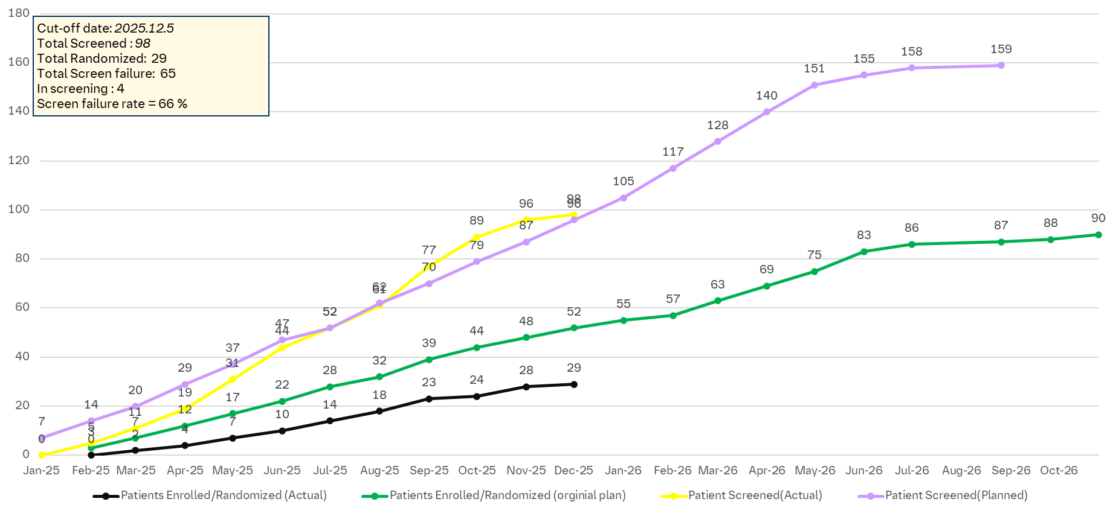
Global Recruitment Curve

Slide 40
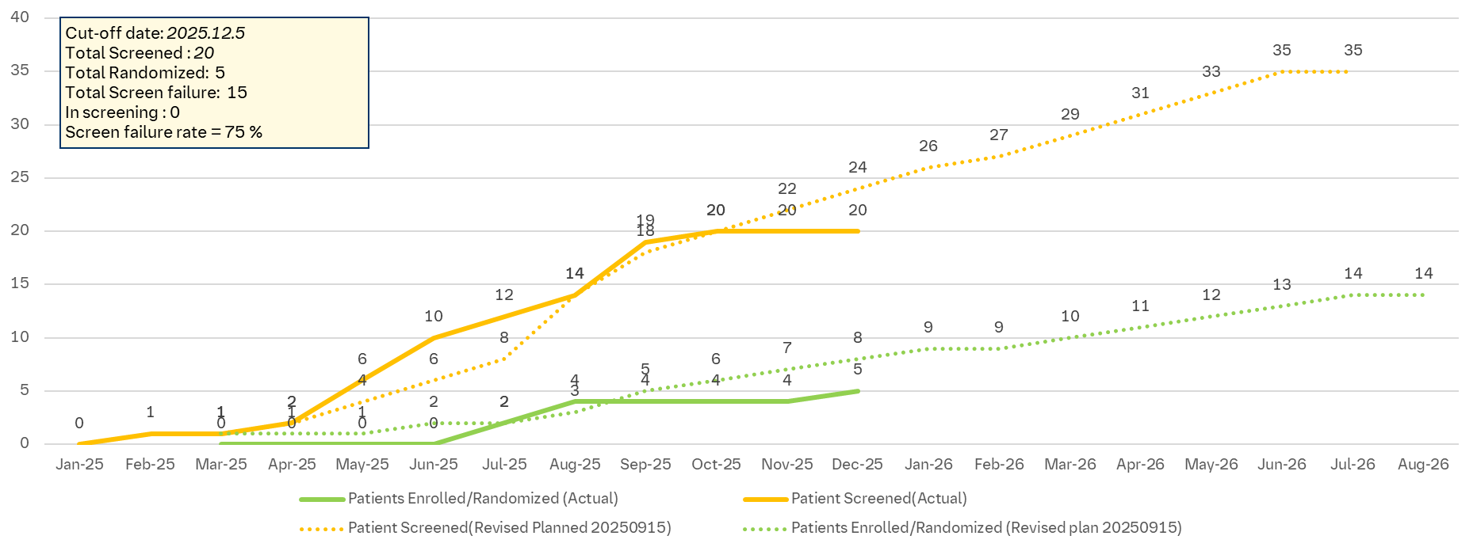
China Recruitment Curve

Slide 41
Challenges and actions for PG Ph III study enrollment
Recruitment Challenges
Limited Recruitment Pool
  Rare disease
  Difficult for PG diagnosis – exclusive diagnosis
  Potential patients with stable disease ​(ulcer healed)
  Complex comorbidities and treatments of PG
Uncertain patient source: patients scattered in different departments (dermatology, rheumatology, gastroenterology, burns and traumatology)
Low patient willingness for clinical trials​
  Low awareness ​
  Potential patients with disease controlled with current treatments
  Placebo trial design : patients with high disease burden with high need for timely and effective treatments​​
Actions
2025 |  |  |  | 2026
Q1 | Q2 | Q3 | Q4 | Q1 | Q2 | Q3 | Q4
CDO
&CD
Co-visit for SIVs
(by CTM and Local Physician)
Advertisements (by Sites & subsidiary hospitals)
Weekly Newsletter delivery
Pre-screening for potential patients (by sites)
Interim IM
Last patient Randomization Oct2026
CRA Workshop
CRA Workshop
CRA refresh training
Investigator Exchange forum @all sites
Investigator Exchange forum @ CHN7
Investigator Exchange forum per needs
MSLs
MSL Training
MSL Activities (site engagement and referral mapping)
HCP and Patient Trial Materials
Trial Awareness @ congresses (Derm, GI, Rheum, Wound Care)
Co-visit for sites
Monthly meeting with CD&O to share medical insights
CFT
leverage by PAG support
Media Outreach
We are here

Slide 42
Update Early Pipeline

Slide 43
Overview: China Development Plan – early assets
Asset | Indication | Status | Notes
BI 3000202 (cGASi) | SLE and IFN | Integration strategy endorsed | CDE agreed to backloading PK trial to join Ph 2 study in Aug 2025. F2F visit to leading PI – Mengtao Li and sub-I on 10th Nov., for communications on final protocol, study plan and 30WD CTA process. Package for 30WD CTA submission in preparation, targeting submission to CDE in Jan2026.
BI685509 (Avenciguat) | SSc | Ph II trial is ongoing. | iDBL for primary analysis achieved on 19th Nov. EoP2 is planned in Q1 of 2026. TLR on 1Dec. Waiting for BUEC’s decision on RoFD which is planned on 18Dec.
BI 1819479 (ATXi) | IPF | Ph II trial(1462-0004) is ongoing. | EoT achieved on 18Nov. DBL planned on 20Feb2026
BI 1839100 (TRPA1i) | IPF | Ph II trial (1490-0004) terminated by IUEC on 2nd Sep since pre-specified PoCP criteria was not met. | All 17 patients from China were out, all data cleaned. Final DBL on 5Dec.
BI 3032950 (anti-TREM1) | IBD (CD and UC) | Integration strategy endorsed | CDE agreed to backloading PK trial to join Ph 2 study in Jun 2025. Ph2a interim analysis results shared by Nov 11, supporting the continuation of ph2a. TLR Mar2026
BI765423 (IL-11) | IPF | Integration strategy endorsed | CDE agreed to backloading PK trial to join Ph 2 study in May 2024.

Slide 44
Back-up

Slide 45
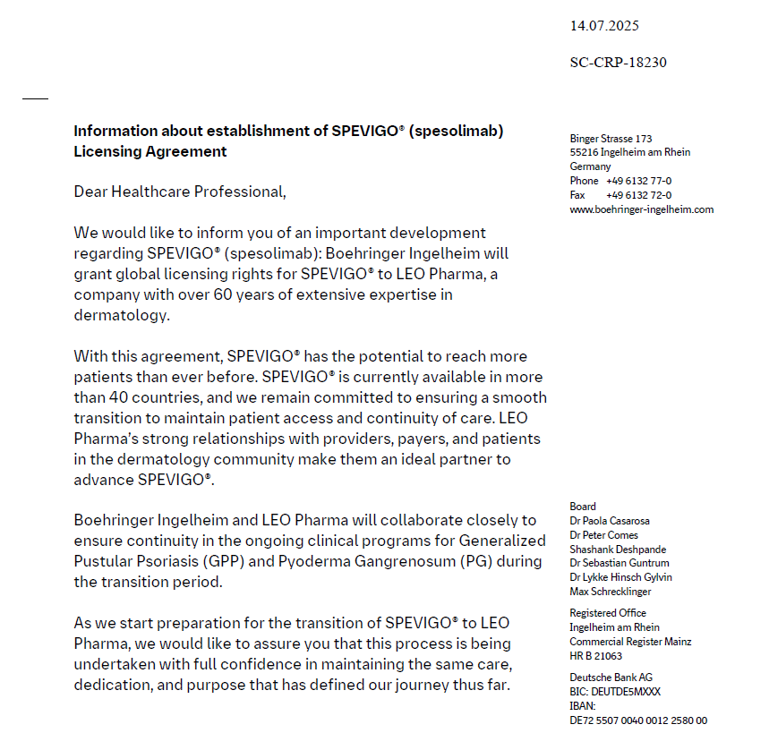
SPEVIGO® (Spesolimab): - License out
Boehringer Ingelheim will grant global licensing rights for SPEVIGO® to LEO Pharma on 1 Oct 2025.
Boehringer Ingelheim and LEO Pharma will collaborate closely to ensure continuity in the ongoing clinical programs for GPP and PG during the transition period.

Slide 46
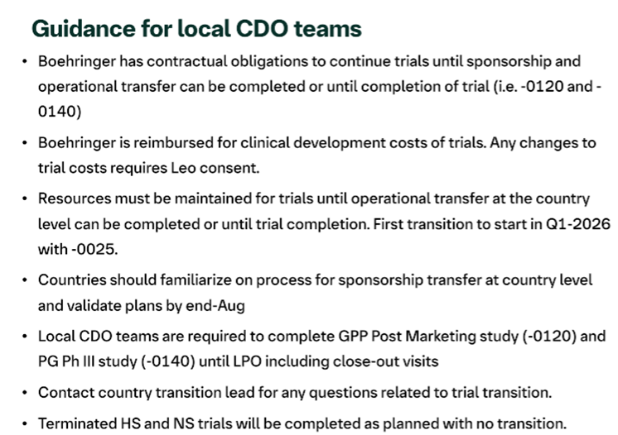

Slide 47
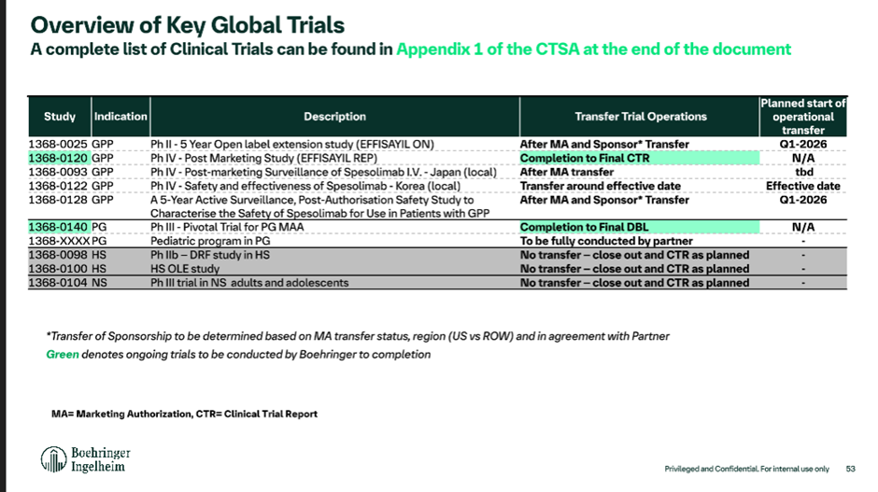

Slide 48
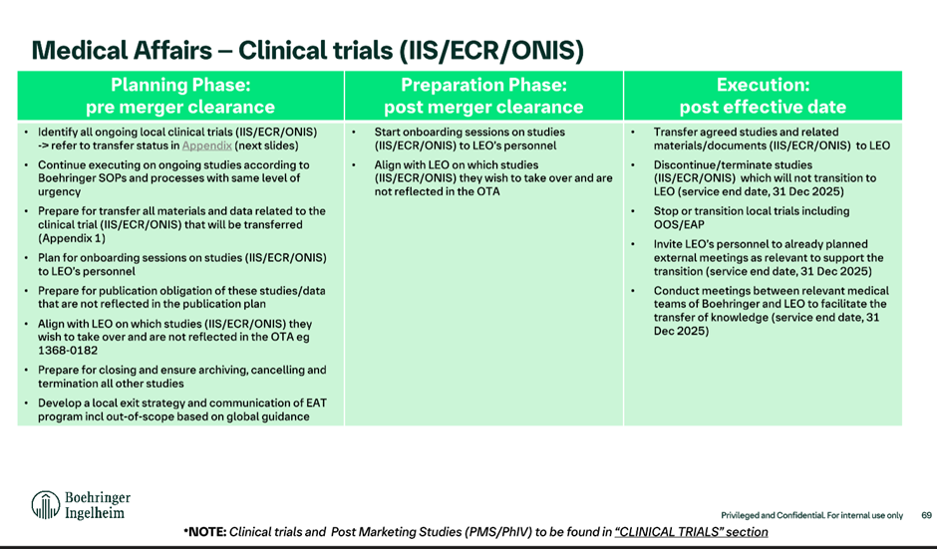

Slide 49
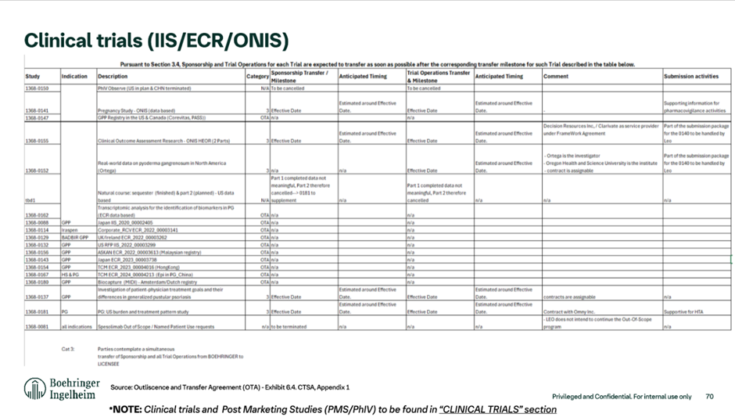

Slide 50
China is the current Top 1 recruiter (cut-off date: Sep 15, 2025)
19 Screened
6 In screening
9 Screen failed
4 Randomized

Slide 51
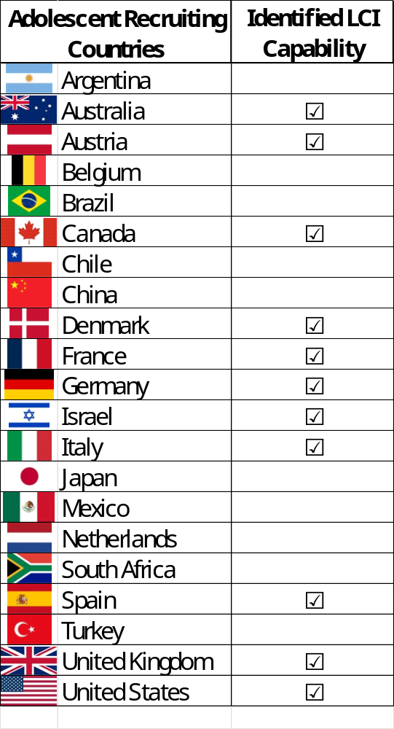
1397-0014 Amendment for the inclusion of adolescents LCI
LCI (lung clearance index): 11 countries have the capabilities to perform the LCI (25 sites)
LCI/MBW is a procedure which is difficult to standardize and interpret.
CORC centralizes and trains sites to conduct LCI in a standardized manner but also does a central readout.
  CORC is based in UK and was already validated and contracted for the Lenitvirus program
  CORC has partners in the US and Australia which might depending on capabilities perform these services in Australisia and the US, however, these partners are not validated by BI and would require separate contracts
  Team is currently collating all relevant information from the sites for the discussions with CORC and aims to have a contract only with this institute
  Evidence Team agreed to go with the sites first who can be covered by the CORC institute and if need be these will be the only ones; however, trial team to look into further solutions in parallel

Slide 52

1397-0018 trial (OLE) design (tbd Airtivity-on)
Long term safety and efficacy of BI 1291583 in patients with bronchiectasis
open label, uncontrolled trial for patients with bronchiectasis who completed AIRTIVITY or CLAIRLEAF
AIRTIVITY 2.5mg
R
Verducatib 2.5mg
AIRTIVITY placebo
Primary endpoint
Occurence of TEAs
Secondary endpoint
Annualized rate of PEx (no adjudication)
Change from baseline in FEV1 and FVC
Substudy
HRCT follow up for participants of the AIRTIVITY HRCT substudy 2 years after initial baseline CT in AIRTIVITY
Currently no further exploratoy efficacy endpoints planned
– tbc by Value
Site visit every 6 months
In between 1 phone visit
D1
w12
w26
w40
w52

Slide 53
Key assessments AIRTIVITY vs OLE trial comparison
Category | AIRTIVITY | OLE
Safety | Adverse events reporting incl. PEx review - PEx adjudication | Adverse events reporting incl. PEX review – no adjudication
 | Physcial exam, height, BW, Tanner stage | Physcial exam, height, BW, Tanner stage
 | Safety lab | Safety lab
PFT | PFT (LCI) | PFT (LCI)
PROs | PROs: BEST, Qol-B, CAAT, abbrev. SNOT-22, cough severity NRS (SGRQ at baseline) | x x
Biomarkers | Sputum: biomarkers, Murray sputum color chart, P.aeruginosa | x x
 | Blood biomarker samples | x
HRCT Sub study | Substudies: cough and sputum, HRCT | Substudies: follow up HRCT
PK | PK blood samples | x

Slide 54



Competitive landscape in NCFBE/ ‘One’ BE → it’s all about differentiation
2024
2025
2026
2027
2028
2029
2030
2031
BI 1291583
Ph III: AIRTIVITY® (‘One’ BE)
PoCC
RoFD
Launch US, EU, JP, CN
~4.5 years gap
~2 years gap
Brensocatib
Ph III data
Launch US, EU/JP in NCFBE
Ph III: China only
Similar time of entry
Ph II data
Launch CN
Ph IIb/ III: outside China – tbd*
Launch US, EU/JP
Further competition:
Itepekimab (anti-IL33, Sanofi/Regeneron): Ph II ongoing with potential launch in 2031
Insmed brensocatib lifecycle indication expansion into CRSsNP and HS
Two additional CatCi in early (clinical) development
Other new MoAs in early development in bronchiectasis
* Little knowledge about Chiesi program at this time
Notes:
EU Feb
JP Apr
CN (end of) Jun

Slide 55




In-Class Competitor landscape in NCFBE/ ‘One’ BE
2024
2025
2026
2027
2028
2029
2030
2031
BI 1291583
Ph III: AIRTIVITY® (‘One’ BE)
Launch US CN
~4.5 years gap
~2 years gap
Brensocatib
Ph III data
Launch US, EU/JP in NCFBE
Ph III: China only
Similar time of entry
HSK31858
Ph II data
Launch CN
15 sites in overlap
Licensed out
Nov 20, 2023
Ph IIb/ III: outside China – tbd*
Launch US, EU/JP
Ph II China
Ph III China - timeline tbd
~1 year later？(TBD)
XH-S004
15 sites in overlap
LPLV 2027-04-28
Launch CN (tbd)
Licensed out
Aug 11, 2025
Ph II outside China – tbd*
Ph III outside China – tbd*
Ph II China
Ph III China - timeline tbd*
~2 year later？(TBD)
RSS0343
12 sites in overlap
Launch CN (tbd)
LPLV 2027-12
We are here
* Little knowledge about this program currently
Notes:
EU Feb
JP Apr
CN (end of) Jun

Slide 56


Competitor landscape beyond DPP1 inhibitors in NCFBE/ ‘One’ BE
2024
2025
2026
2027
2028
2029
2030
2031
BI 1291583
Ph III: AIRTIVITY® (‘One’ BE)
Launch US, EU, JP, CN
GSK3862995B
(aIL-33 mAb)
China Joining Global Ph II (NCFBE, n=363)
China Joining Global Ph III (tbd*)
7 sites in overlap
Launch CN (tbd*)
LPLV 2027-12
Similar time of entry
China Joining Global Ph II (NCFBE, n=312) (Enrolment completed)
China Joining Global Ph III (tbd*)
China Joining Global Ph II (NCFBE, n=363)
Itepekimab
(aIL-33 mAb)
Launch CN (tbd*)
8 sites in overlap
LPLV 2026-02-02
* Little knowledge about this program currently
Local competitions for trial enrolment：
Two ph2 and 1 ph3 trials for other DPP1 inhibitors are ongoing
  10-15 overlapping sites with each competitor
Two aIL-33 mAb ph2 trials are ongoing
  7-8 overlapping sites with each competitor
Notes:
EU Feb
JP Apr
CN (end of) Jun

Slide 57
Overview of In-Class DPP1/CatC Inhibitor Competition
 | BI 1291583 phase 2 data | HSK31858 (Florensocatib) phase 2 data
MoA | DPP1/CatC inhibitor
Formulation & RoA | Once daily oral tablet (2.5mg) | Once daily two oral tablets (2x20mg)
Description of MoA / pharma-cological effect | Reduces NSPs and with that neutrophilic inflammation in the lung
Population | BE ≥ 2 PEx in past year or 1 PEx + high symptom score | NCFBE (primary diagnosis of COPD/asthma was excluded) ≥ 2 PEx in past year (Haisco)
EP - reduction in PEx | Key 2° EP: 32.3% (47% for Asian sub-group, n=14) at 2.5mg | 1° EP: 46.8% (20 mg, n=74) and 60.1% (40mg, n=75)
EP - time to first pulmonary exacerbation | 1° EP: 34% risk reduction in events at 2.5 mg (n=53) (HR=0.66) (59% for Asian sub-group, n=14) | 2° EP: 57% and 67% reduction in events at 20 mg (n=74) and 40 (n=75) mg (HR=0.43 and 0.33)
 | Note: Non-head-to-head comparison & baseline demographics differ between BI and HSK HSK31858 data were only generated in Chinese population BI 129583 data in Asian sub-group was comparable with HSK31858
Coming ~4.5 years (globally) and ~2 year (China) later, having strong and differentiating* data at launch is key.
Several areas for differentiation are being explored and focused investment into evidence generation beyond Ph III is proposed to react flexibly to competitive positioning and market development
*Statements regarding differentiation or comparison to competitors are aspirational only; no superiority or comparative claims will be made upon approval due to lack of head-to-head data. All claims must be approved by HPRC.
57

Slide 58
Local strategy to move forward… (draft)
Based on the expedited global recruitment timeline & increasing competition from external pipelines in China
Activities | Purpose | Lead Role
Cross-trial comparison: Key Eligibility Criteria Dive-in Key Study Process Dosing form (oral vs IV/SC) Prior efficacy & safety data MoA advantage Trial stage (ph2 vs ph3) | Identify differentiating advantages & benefits for patients | Medical/Clinical
Site/PI Engagement: Boost visit? City Meetings? Ab meeting | Engage trial participating PIs Leverage the connection of the PI with experts not participating AIRTIVITY trials for referral | CD&O
External Promotion: WeiXin/WeChat official platform National/Regional Congress/Conference | Increase exposure to external targeted experts/patients | MA

Slide 59
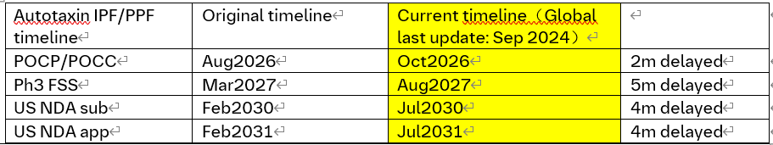
Ongoing:
BI 1819479 (Autotaxin inhi): IPF/ PPF
2023 |  | 2024 |  |  |  | 2025 |  |  |  | 2026 |  |  |  | 2027 |  |  |  | 2028-2029 |  |  |  | 2030
Q3 | Q4 | Q1 | Q2 | Q3 | Q4 | Q1 | Q2 | Q3 | Q4 | Q1 | Q2 | Q3 | Q4 | Q1 | Q2 | Q3 | Q4 | H1 | H2 | H1 | H2 | Q1 Q2 | Q3 Q4
We are here
Aug 2024
Nov 2025
Sep 2026
Ph2-
1462-0004
CTA sub
Mar 2024
Ph2 IPF (N=300)
PoCP/PoCC in IPF
Oct 2026
FSS
LSR
Mar 2030
LSC
Aug 2027
Ph3
LSC
RoFD
Jun 2027
Ph3 in IPF
FSS
US app
Jul 2031
Ph3 in PPF
FSS
LSC
US NDA
Jul 2030
Mar 2024
Sep 2024
Oct 2025
Sep 2026
Ph2-
1462-0004
CTA Review + EC + HGRAC + 1st SIV (6m) *
Recruitment window
~12m (Site: 16 N=18)
Ph3 in IPF
1st SIV
LSR
LSC
Ph3 in PPF
Ph3
China PK(for NDA) discussion
CN NDA
Aug2030
CN app
Best caseAug2031
Base Case Feb2032
FSS: First subject Screen
LSC: Last Subject complete
LSR: Last subject randomization

Slide 60
BI 1819479 (Autotaxin inhi): IPF (1462-0004)
Trial Milestones and Performance Overview_12Aug2025
FSS = Sept 5, 2024
Milestone​ | Planned​ | Updated ​ | Actual​
Final Trial Design Outline​ | 07-Dec-2023​ | ​ | 07-Dec-2023​
Final Protocol​ | 22-Feb-2024​ | ​ | 22–Feb-2024​
Final CTA Package​ | 11-Mar-2024​ | ​ | 29-Feb-2024​
First Initiation Visit​ | 22-Aug-2024​ | ​ | 22-Aug-2024​
First Patient Randomized​ | 14-Oct-2024​ | ​ | 02-Oct-2024​
Last Patient Randomized​ | 20-Nov-2025​ | 16-May-2025 | ​16-May-2025
Last Patient 24 weeks (w/o visit windows) |  | 31-Oct-2025
Last Patient EoT |  | 14-Nov2025
Last Patient Completed​ | 21-Jul-2026​ | 09-Jan-2026 | ​
Database Lock​ | 01-Sep-2026​ | 20-Feb-2026 | ​
Key Results​ | 22-Sep-2026​ | 13-Mar-2026 | ​
Final Clinical Trial Report (Archived)​ | 23-Feb-2027​ | 14-Aug-2026 | ​
Notes:
The lack of information around IMP availability for EU has the potential to affect study completion timelines

Slide 61
Terminated:
BI 1839100 (TRPA-1 antagonist): IPF/ PPF Cough
2023 |  | 2024 |  |  |  | 2025 |  |  |  | 2026 |  |  |  | 2027 2028 |  |  |  | 2029 |  |  |  | 2030
Q3 | Q4 | Q1 | Q2 | Q3 | Q4 | Q1 | Q2 | Q3 | Q4 | Q1 | Q2 | Q3 | Q4 | H1 | H2 | H1 | H2 | Q1 | Q2 | Q3 | Q4 | Q1 Q2 | Q3 Q4
We are here
75 pts screened
May2025
May
2023
MRD
Jan
2024
Aug 2024
PoCP Sep
Key result
Sep 2026
Ph2-
1490-0004
Ph2a IPF cohort N=180
Ph2b IPF(180)
CTA sub
Feb 2024
PoCC Sep2026
FSS
FSS Oct 2025
Ph2 PPF(50) cohort
FSS Jul 2027
Ph3-
LSLV Apr2026
Ph3 in PF-ILD
FSS Oct2025
CTA sub
Mar 2026
US Launch
Oct 2031
US NDA
Oct 2030
Jul 2023
6 Nov2023
Feb
Resub.
Aug
Ph2-
1490-0004
Pre-IND 3m for written response
CTA Review + EC + HGRAC + 1st SIV (6m) *
N = 14（IPF10,PPF 4）
1st SIV
Ph2 PPF cohort
CN approval
Best: Oct 2031
Base:Apr2032
Jul 2023
Nov 2023
Mar 2027
FSS Oct 2027
JP PK study
CTA Review + EC + HGRAC + 1st SIV (6m)
Ph3 in PF-ILD
FSS
JP PK data
CN NDA
Oct 2030
China PK(for NDA) discussion
FSS: First subject Screen
LSC: Last Subject complete
LSR: Last subject randomization
SQV: Site qualification visit
AEP: Asset evidence plan
HAI: Health authority interaction
Project Update BI 1839100 (TRPA-1 inh) discontinued:​
pre-specified PoCP criteria in Ph IIa study conducted in IPF patients not met. ​
IUEC decision of discontinuation. ​
Terminate and wrap up activities for all clinical and non-clinical ongoing.

Slide 62

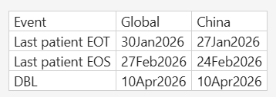
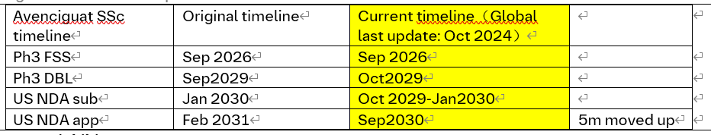
Avenciguat (sGC Activator): Systemic Sclerosis (SSc)： Ph2
2022 |  |  |  | 2023 |  |  |  | 2024 |  |  |  | 2025 |  |  |  | 2026 |  | 2027 |  | 2028 | 2029
Q1 | Q2 | Q3 | Q4 | Q1 | Q2 | Q3 | Q4 | Q1 | Q2 | Q3 | Q4 | Q1 | Q2 | Q3 | Q4 | H1 | H2 | H1 | H2
We are here
Global
Ph2
1366-0031
Dec 2022
Oct 2024
Apr 2025
Dec 2025
Ph2 N=200
LSS-key results
Decision: go/no go
early launch
FSS
LSS
IA 160 patient 24W
Ph3
1366-0033
2026 Sep
Ph3
2029 Oct
NDA sub
Jan 2030
Launch
Sep 2030
China
Ph2
1366-0031
Jun 2022
Dec 2022
China Ph2b CTA sub.-1st SIV (6M)
Ph2 1366.31 recruit. wind. ~22m
CN ML: 16 sites/24 patients; TW: 1 patient
LSS-Key results
CTA
1st SIV
Ph3
1366-0033
Recruitment Window: TBD
sGC: soluble guanylate cyclase
LSS: Last subject screening
LSC: Last subject complete
SQV : site qualification visit
FSS: First subject screening
CN ML: China mainland
China NDA sub
Feb 2030
China PK(for NDA) discussion
China NDA App
Feb 2031 (best)
Jul 2031 (base)
Notes:
CN NDA approval 5m earlier than original plan

Slide 63
BI 3000202 (cGAS inhi) in SLE (1509-0004, ph2)
Timeline / Current status_10Nov2025
Milestones | Global |  | China
 | Planned date | Actual date | 30 CTA accelerate process | Original planned date | Actual date
TDO Final | 06-Oct-25 | 06-Oct-25 | / | / | /
Final Protocol | 17-Nov-25 |  | 30-Nov-25 | 30-Nov-25
Final CTA Package | 27-Nov-25 |  | 12-Dec-25 | 17-Dec-25
CTA submission | 22-Dec-25 |  | 19-Jan-25 | 22-Dec-25
CTA approval | Jan-26 |  | 6-Mar-2026 | 31-Mar-26
First EC submission |  |  | 5-Jan-25 | 15-Feb-26
First EC approval |  |  | 6-Feb-26 | 30-Mar-26
HGRAC submission | / | / | 15-Mar-26 | 1-May-26
HGRAC approval | / | / | 15-Apr-26 | 30-May-26
First SIV | 06-Apr-26 |  | 30-Apr-26 | 22-Jun-26
First Subject Screened | 07-Apr-26 |  | 15-May-26 | 30-Jul-26
First Subject Randomized | 12-May-26 |  | 15-Jun-26 | 30-Aug-26
Last Subject Randomized | 25-Jun-28 |  | 25-Jun-28 | 25-Jun-28
DBL | 15-Jul-29 |  | 15-Jul-29 | 15-Jul-29

Slide 64
Interaction to align with CDE on China participating in the Global Phase II trial of BI 3000202 in SLE – submitted on 27 May 2025
Feedback from CDE regarding China integration in global phase II study - 1509.0004
Clinical division | Clin-pharm division
July 25th 2025 Based on the briefing document, China join the global phase II MRCT is reasonable. | Aug 20th 2025 Agree with China join the global Phase II clinical trial.
When submit the CTA, please provide the rationale that no safety risk to increase exposure in Asian SLE patients. The final review decision shall prevail. | It is recommended that in the global Phase II clinical trial, enroll Chinese patients in low-dose (25mgBID) arm firstly and compare the PK, PD and safety data obtained from these Chinese patients with the entire population. If the above characteristics are basically consistent, then enroll Chinese patients in higher dose arms.
→ Justify in the CTA that increased exposure poses no safety risk for Asian SLE patients. | Strategy to push back CDE‘s recommendation (submitted on 27 Aug） Alignment meeting on 26 Aug – global & local teams
N.A | CDE accepted with further comment on 29 Aug: Suggest to comprehensively consider the available data to ensure the safety of the subjects. When submit the CTA, please provide the detailed rationale that no safety risk to increase exposure in Asian SLE patients.
 | → Justify in the CTA that increased exposure poses no safety risk for Asian SLE patients.

Slide 65
Leading PI endorsed by ad hoc PEC (9th Oct)
Potential investigator name** | Hospital/ department** | Academic experience, especially in clinical studies (weight 15%**) | Impact in Therapeutic Area (weight 20%**) | Leading PI feasibility (weight 30%**) | Leading site start up timeline feasibility (weight 35%**) | Total Grade | Finial proposal for leading PI selection (Y/N)
李梦涛 | 北京协和医院 | Prof Li focus on the treatment of SLE, sjogren syndrome, rheumatoid arthritis, spondyloarthritis, systemic vasculitis, scleroderma, dermatomyositis, connective tissue disease-related pulmonary hypertension and other rheumatoid immunopathy. 1. Clinical trial experience: China Leading PI and global SC member in 1305-0046 ph3b trial (SARD-ILD); China leading PI in Belimumab ph3 in CTD-ILD (GSK), and PIT565 ph1 (Novartis). Lead 3 China single center clinical studies​. Several sub-I experiences in global/local RCT (leading PI 曾小峰） ​ 2. <Recommendations for diagnosis and treatment of systemic lupus erythematosus 2025> author 3. Published 138 Sci-cited papers related to SLE Grade: 9/10 (13.5) | 第十二届中华医学会风湿病学分会委员会主任委员；北京医学会风湿病学分会主任委员；中国医师协会风湿免疫科医师分会副会长兼肺血管/间质病学组组长；亚太抗风湿病联盟（APLAR）系统性红斑狼疮研究组成员；亚太系统性红斑狼疮协作组（APLC）成员；中国系统性红斑狼疮研究协作组（CSTAR）、国家风湿病数据中心（CRDC）、中国风湿免疫病医联体联盟（CRCA）秘书长，国家皮肤与免疫疾病临床医学研究中心（NCRC-DID）办公室主任 Grade: 10/10 (20) | Leading PI of 1305-0046 (SARD-ILD,ph3) CTID: 5 leading I-III studies (2 SLE ph1 studies, collaborate with MNCs like Novartis and GSK, and other local biotechs.) The experience of leading PI is limited, especially for MRCT. Grade：6/10 (18) | Trial Set up: 2 weeks EC approval: 1-1.5 months HGRAC: 2 weeks to get signature Contract negotiation: MSA (renew is under negociation), 2 months to finalize (risk: publication and IP sharing) EC submission ahead of CTA approval; bi-weekly EC meeting; EC/CTA in parallel review Summary: 4-6 months for initiation meets the 6 months benchmark of BI ; Lading site for 1305-0014 & 1305-0023 & 1305-0031 (ILD, ph3)/1305-0046 (SARD-ILD, ph3)/1366-0031(SSc, ph2) study Risk: Potential publication per PI’s request and IP sharing. Grade: 9/10 (31.5%) | 81.25% | Y 1509-0004

